Slide 1
Impact of stellar variability on the observational appearance of protoplanetary disks
Alexandra Botnariuc
Supervisors:
Prof. Ronald Redmer, Universitaet Rostock
Prof. Sebastian Wolf, CAU Kiel
26/03/19
© 2009 UNIVERSITÄT ROSTOCK | FAKULTÄT FÜR INFORMATIK UND ELEKTROTECHNIK
‹#›

Slide 2
Overview
Introduction and motivation
Observations and instruments
Visibility curves
Method
Results
Conclusions
26/03/19
© 2009 UNIVERSITÄT ROSTOCK | FAKULTÄT FÜR INFORMATIK UND ELEKTROTECHNIK
‹#›

Slide 3
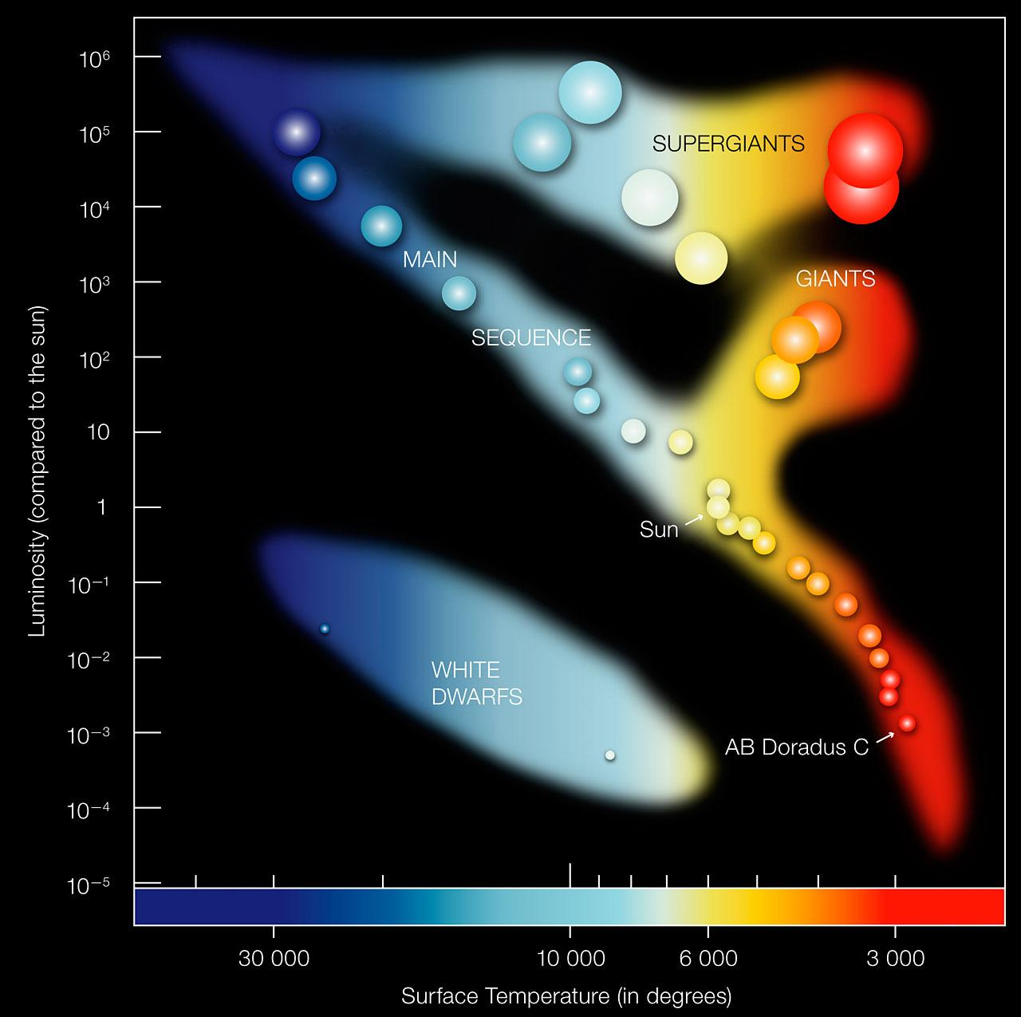
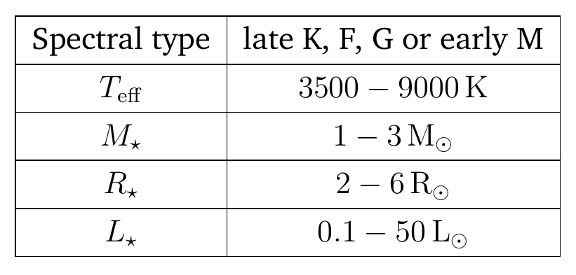
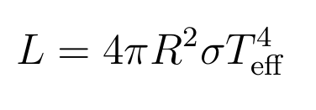
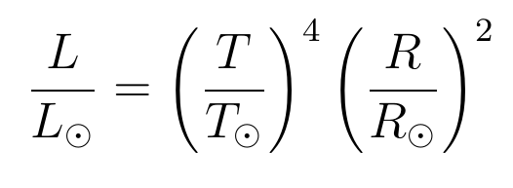
T Tauri Stars
T Tauri
Figure 1: Hertzsprung-Russell Diagram Credit: ESO
9/12/18
© 2009 UNIVERSITÄT ROSTOCK | FAKULTÄT FÜR INFORMATIK UND ELEKTROTECHNIK
‹#›

Slide 4
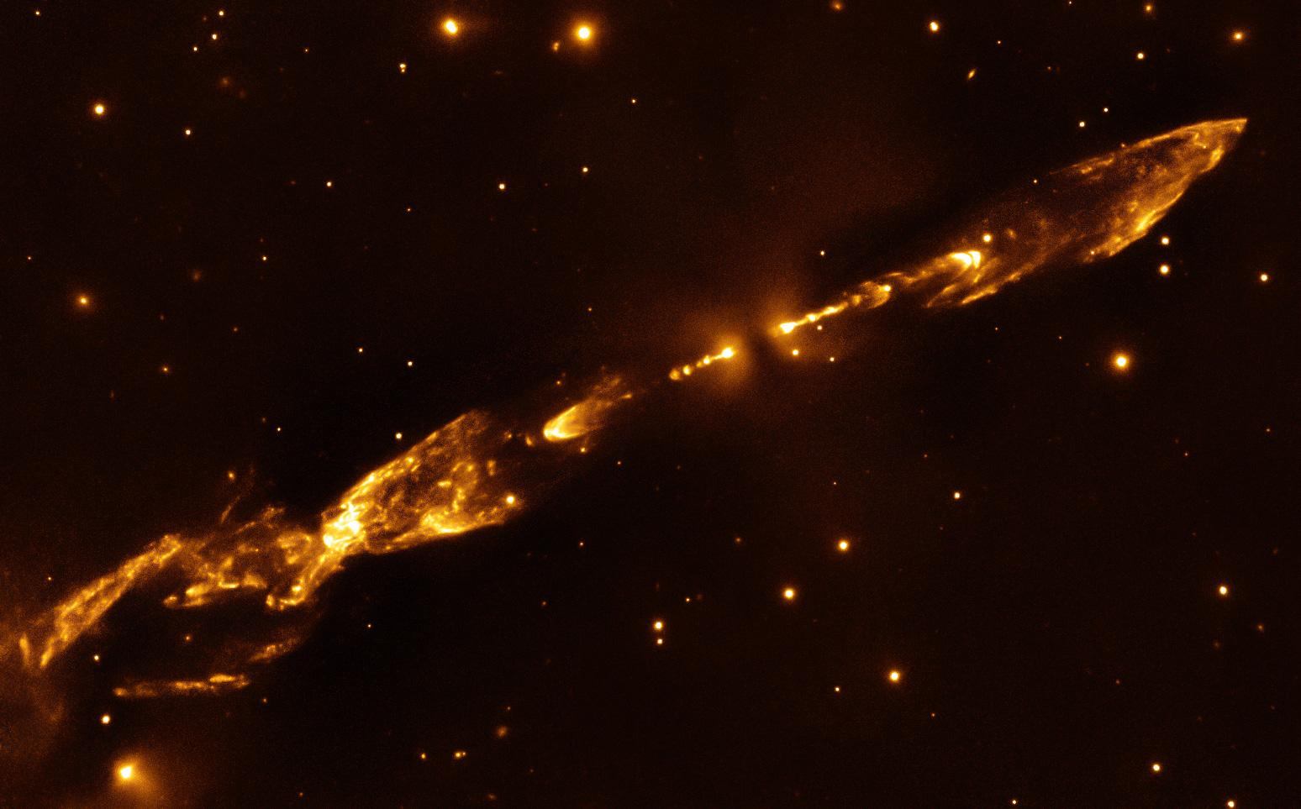
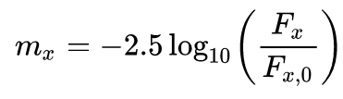
Luminosity variability
Figure 2: Herbig-Haro object (HH) 212, located in Horsehead Nebula star-forming region.
Credit: ESO/M. McCaughrean
9/12/18
© 2009 UNIVERSITÄT ROSTOCK | FAKULTÄT FÜR INFORMATIK UND ELEKTROTECHNIK
‹#›

Slide 5
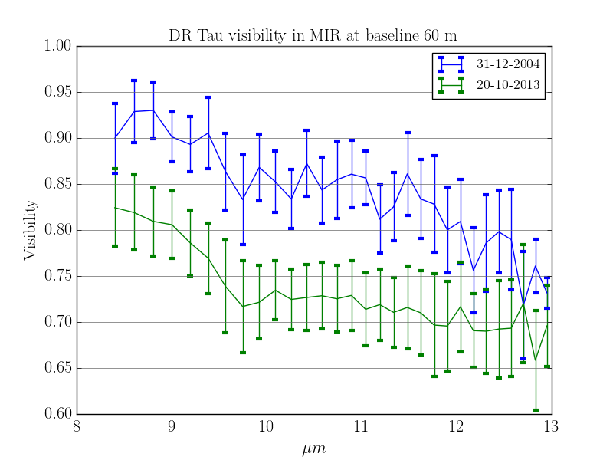
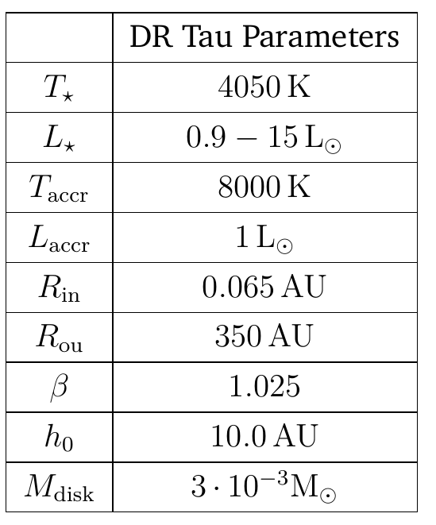
The curious case of DR Tau
Model B, R. Brunngräber, 2018
26/03/19
© 2009 UNIVERSITÄT ROSTOCK | FAKULTÄT FÜR INFORMATIK UND ELEKTROTECHNIK
‹#›
Notes:
So that is how we can interpret visibility, keep in mind fourier transform I can show you this graph
These are visibility values per wavelength, which I will talk about in a minute. It can be deceiving. What is important to note is tat the visibility for the same observation conditions changed 10 years later. Which can only mean that the object changed, being the conditions are identical.
Set out to investigate if the change in Luminosity could explain the modifications in the visibility in DR Tau - a T Tauri star with a circumstellar disk, in MIR

Slide 6
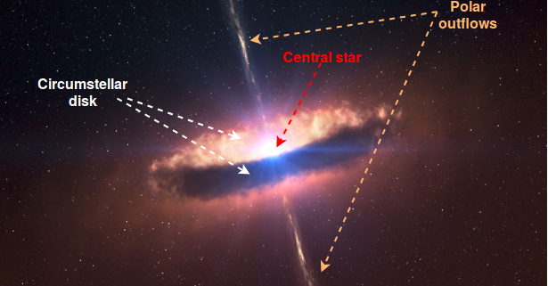
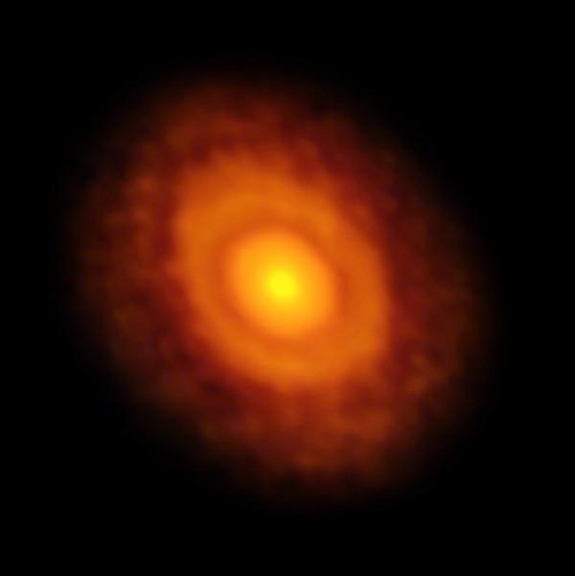
Circumstellar disks
Figure 4: V883 Orionis [ALMA in long-baseline mode].
Credit:ALMA (ESO/NAOJ/NRAO)/L. Cieza
Figure 3: Circumstellar disk Credit: ESO/L. Calçada/M. Kornmesser
26/03/19
© 2009 UNIVERSITÄT ROSTOCK | FAKULTÄT FÜR INFORMATIK UND ELEKTROTECHNIK
‹#›

Slide 7
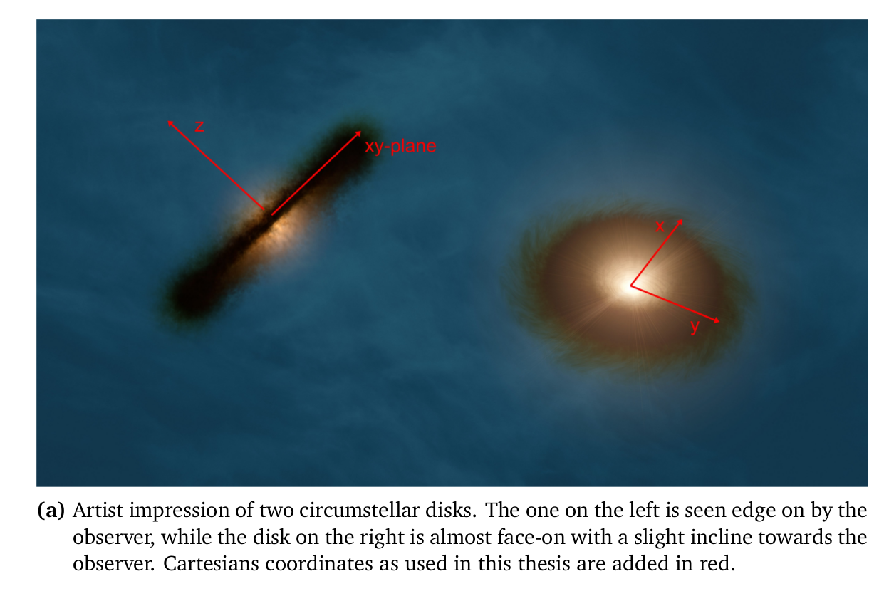
Circumstellar disks
Credit: ESO
26/03/19
© 2009 UNIVERSITÄT ROSTOCK | FAKULTÄT FÜR INFORMATIK UND ELEKTROTECHNIK
‹#›

Slide 8
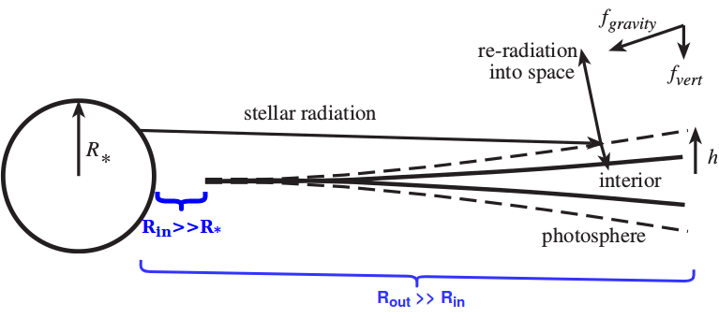
Protoplanetary disk model ^{[5]}
Figure 5: Flaring disk in xz plane. Credit: Beckwith, 1999 (adaptation in blue)
26/03/19
© 2009 UNIVERSITÄT ROSTOCK | FAKULTÄT FÜR INFORMATIK UND ELEKTROTECHNIK
‹#›

Slide 9
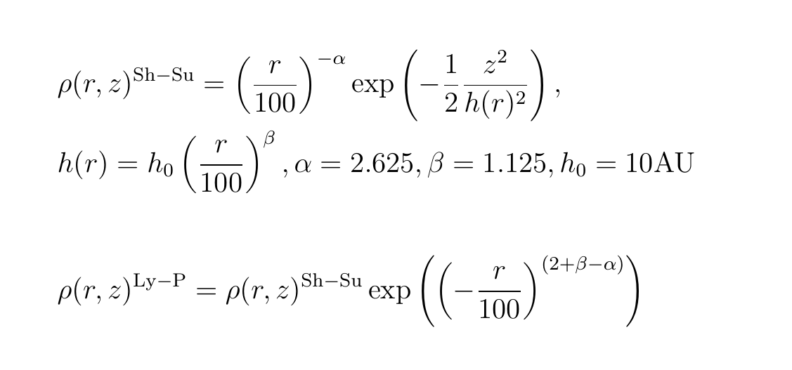
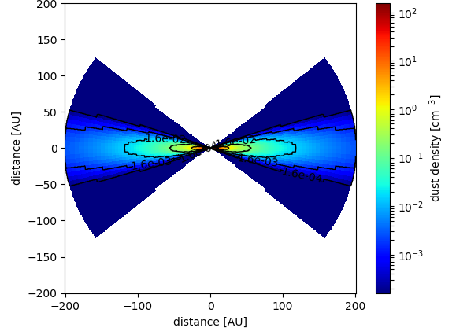
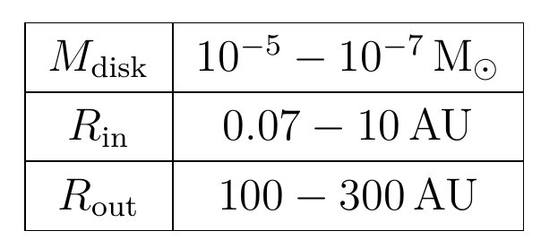
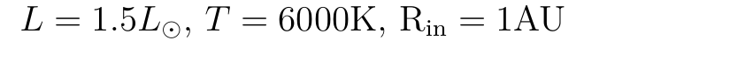
Disk density distribution
Disk parameters:
Figure 6: Dust number density in xz-plane
26/03/19
© 2009 UNIVERSITÄT ROSTOCK | FAKULTÄT FÜR INFORMATIK UND ELEKTROTECHNIK
‹#›
Notes:
Beta describes how flared the disk will be
h_0 scaling factor for heigth
Density factor alpha
Exponentially decaying density
Disk less dense in outer region and densely packed near the star

Slide 10
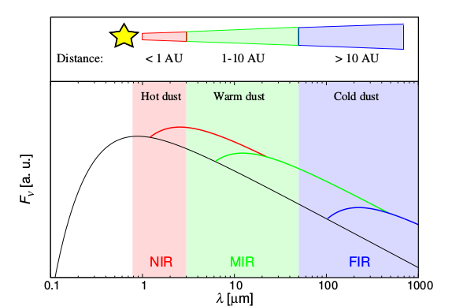
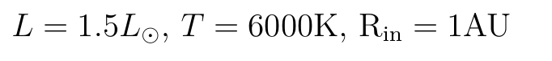
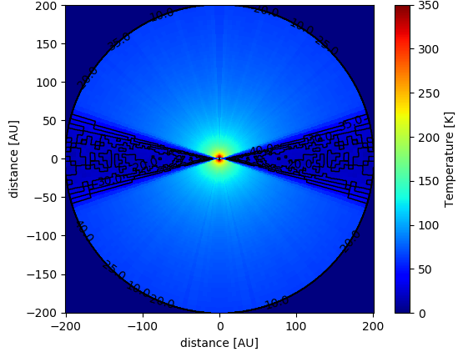
Figure 7: Temperature in xz-plane
Figure 8: Illustration of inner edge dust contributions to different parts of the SED. The dark line corresponds to a sun-like star, and the flux maxima are arbitrary.
Credit: Kirchschlager et al., 2017
26/03/19
© 2009 UNIVERSITÄT ROSTOCK | FAKULTÄT FÜR INFORMATIK UND ELEKTROTECHNIK
‹#›
Notes:
Mol3d => Monte carlos radiative transfer between star adn disk
Dust temperatures near star 100 - 1000 K => disks are better observed in the infrared
NIR for dust close to star, MIR for cooler gas (300 K), Far Infrared for even cooler. \
Dust optically thick in the visible range
Scatters UV light due to size, and allows IR to pass through
Interstellar dust causes reddening of the light/image adding a peak at approx 6 micron
Traditional telescopes are not large enough to observe such faint, distant objects
Astronomical interferometer is an array of separate telescopes, mirror segments, radio antennas that work together to provide a higher resolution image

Slide 11
2. How do we observe circumstellar disks?

Slide 12
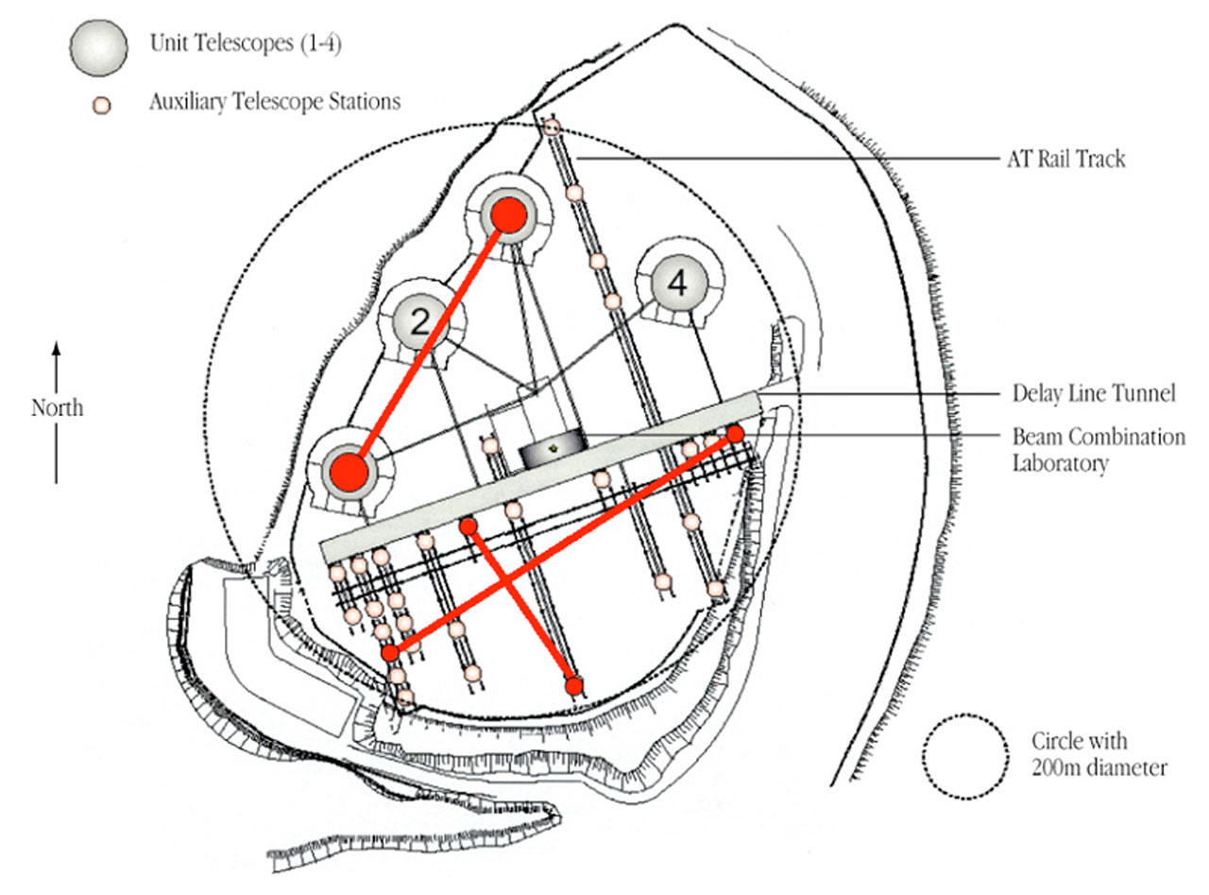
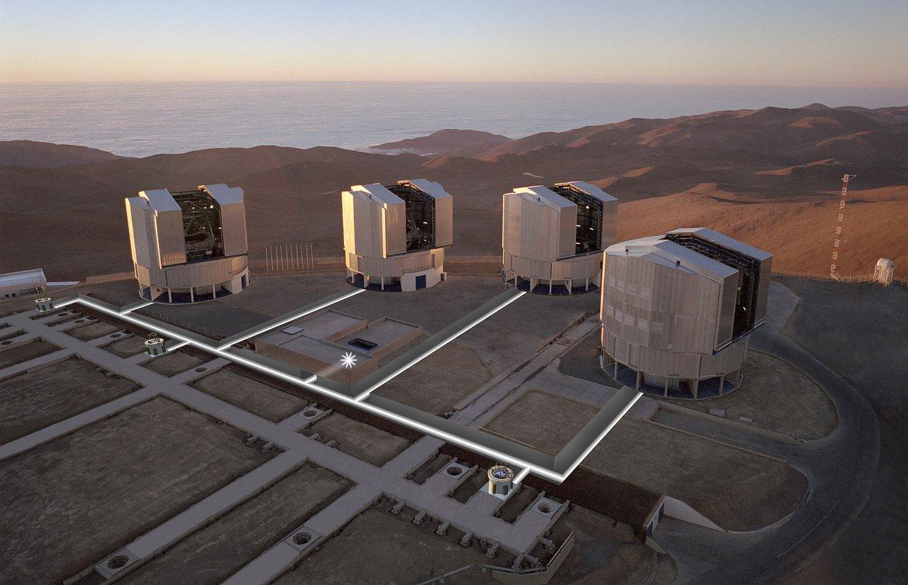
VLTI
Figure 9: Schematic of VLT array
Credit: ESO
Figure 10: The Unit telescopes at VLT, Paranal Observatory, Atacama Desert, Chile, 2 635 m
Credit: ESO
26/03/19
© 2009 UNIVERSITÄT ROSTOCK | FAKULTÄT FÜR INFORMATIK UND ELEKTROTECHNIK
‹#›
Notes:
VLTI: VLT (or Very Large Telescope) is European project mainly made of four 8 m telescopes (Unit Telescopes or UT) and a series of “small” 1.8 m telescopes (Auxiliary Telescopes or AT).
Today, 4 ATs and 4 UTs are operational with baselines ranging from 16 m to 130 m.
Today’s VLTI is limited by vibrations, which are under investigation and should be solved in the next few years.

Slide 13
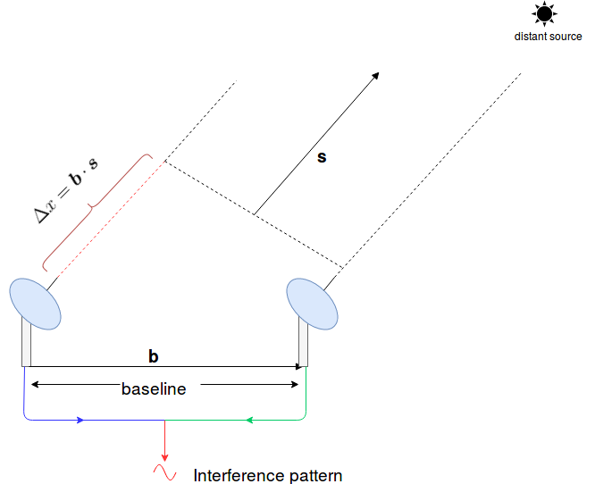
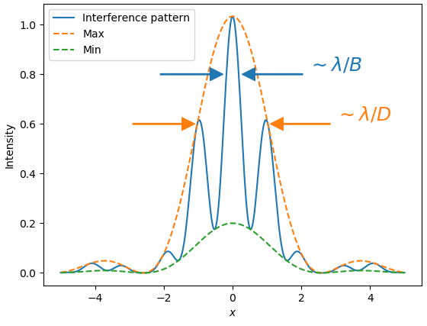
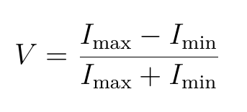
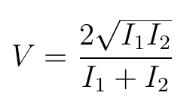
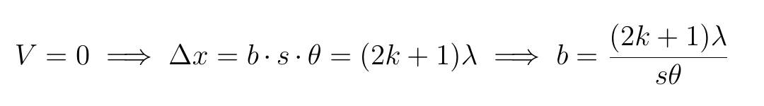
Visibility
26/03/19
© 2009 UNIVERSITÄT ROSTOCK | FAKULTÄT FÜR INFORMATIK UND ELEKTROTECHNIK
‹#›
Notes:
So how does an astronomic interferrometer work and how do we define the visibility?
Imagine 2 such telescopes with a distance b, which we call a baseline, between them. By combining the light coming from a distant source, because the beams will have a path difference, we obtain an interference pattern.
If we think about the interference pattern in classical interferometer or a double slit experiment visibility is just … or for two monochromatic sources of different intensity and the same polarization
When V is 1 we have no distinguishable interference patter
V is 0 for certain values of the baseline, given the freqency and the span of the region to see
Classical Interferometers
(ike the Mach–Zehnder interferometer, Michelson interferometer, and Sagnac interferometer)

Slide 14
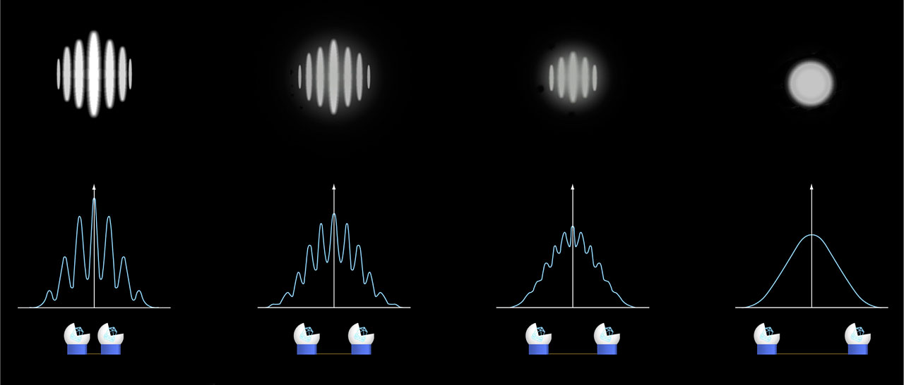
Visibility
Interference fringes in relation to telescope baseline.
Credit: ESO
26/03/19
© 2009 UNIVERSITÄT ROSTOCK | FAKULTÄT FÜR INFORMATIK UND ELEKTROTECHNIK
‹#›
Notes:
So how does an astronomic interferrometer work and how do we define the visibility?
Imagine 2 such telescopes with a distance b, which we call a baseline, between them. By combining the light coming from a distant source, because the beams will have a path difference, we obtain an interference pattern.
If we think about the interference pattern in classical interferometer or a double slit experiment visibility is just … or for two monochromatic sources of different intensity and the same polarization
When V is 1 we have no distinguishable interference patter
V is 0 for certain values of the baseline, given the freqency and the span of the region to see
Classical Interferometers
(ike the Mach–Zehnder interferometer, Michelson interferometer, and Sagnac interferometer)

Slide 15
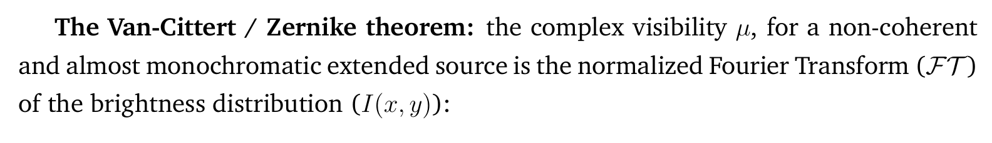
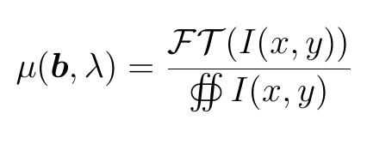
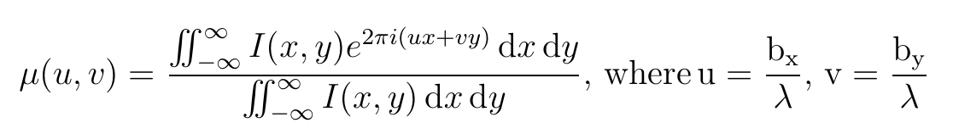
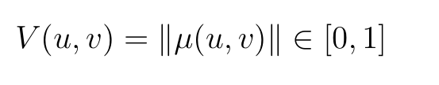
Visibility μ
26/03/19
© 2009 UNIVERSITÄT ROSTOCK | FAKULTÄT FÜR INFORMATIK UND ELEKTROTECHNIK
‹#›
Notes:
In the case of 2D images which do not have point sources, but a distribution we use the Van Cittert Zernike theorem to define visibility
This state that a distance enough source can be considered coherent and the complex visibility mu is the normalize Fourier transform of the source
(u,v) coordinate of telescopes, (x,y) real coordinates in circumstellar disk image
Visibility V, as used from now on is the modulus of the complex visibility mu

Slide 16
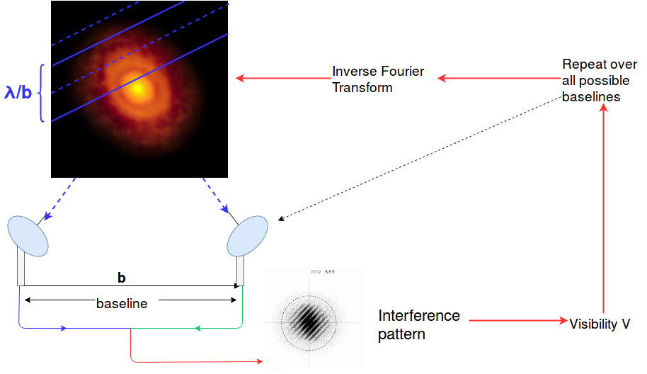
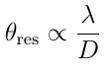
Visibility V
26/03/19
© 2009 UNIVERSITÄT ROSTOCK | FAKULTÄT FÜR INFORMATIK UND ELEKTROTECHNIK
‹#›
Notes:
In theory, when getting observing one such disk, we get a fringe pattern, we calculate one visibility value from it V(b)
If we could then move the telescopes nad cover all baseline (or a large subset) we get can apply the inverse fourier transform and reconstruct the original disk
Interference fringe pattern projected on image for given wavelength and baseline
Solid lines are points for fringe maxima
Dotted lines are for destructive interference/ fringe minima

Slide 17
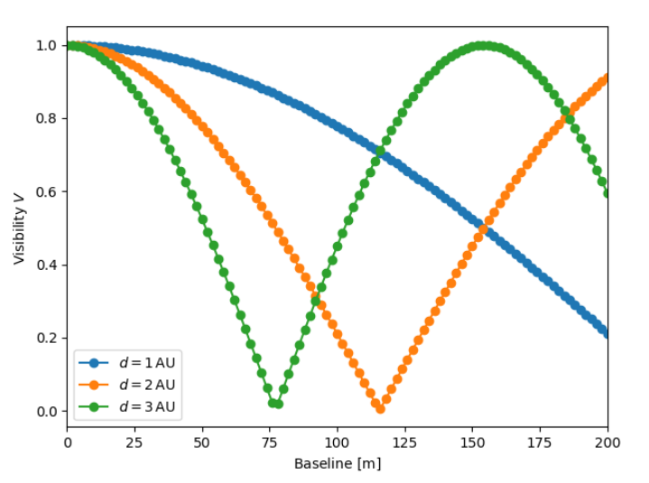
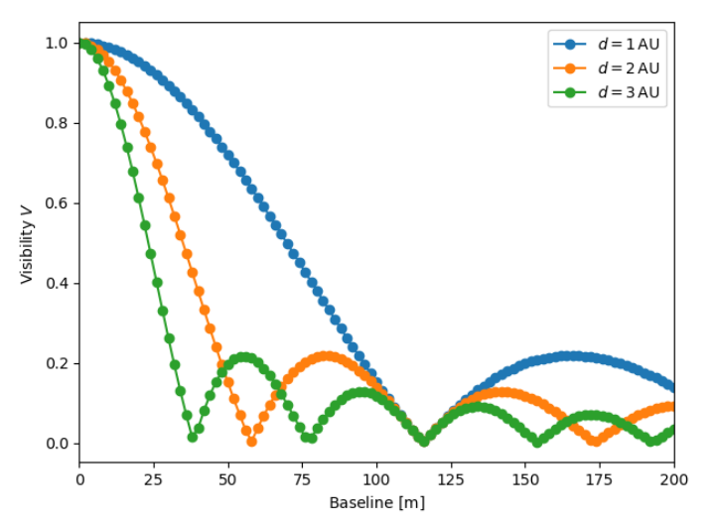
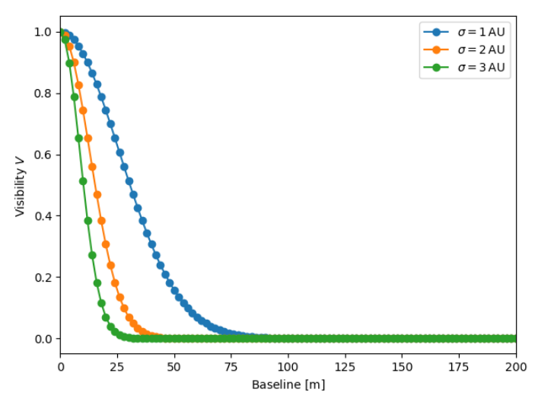
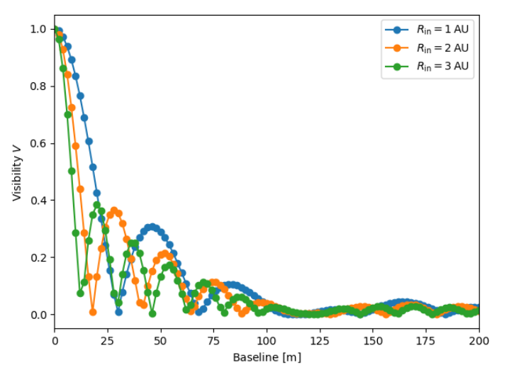
Visibility V, s = 140 pc
y
y
x
x
y
y
x
x
26/03/19
© 2009 UNIVERSITÄT ROSTOCK | FAKULTÄT FÜR INFORMATIK UND ELEKTROTECHNIK
‹#›
Notes:
Point source => Step function (it too would have a minima, but that would be for a baseline of 10^24 m)
2 points => interference, cosine function
Box function => sinc function
Gaussian => Gaussian

Slide 18
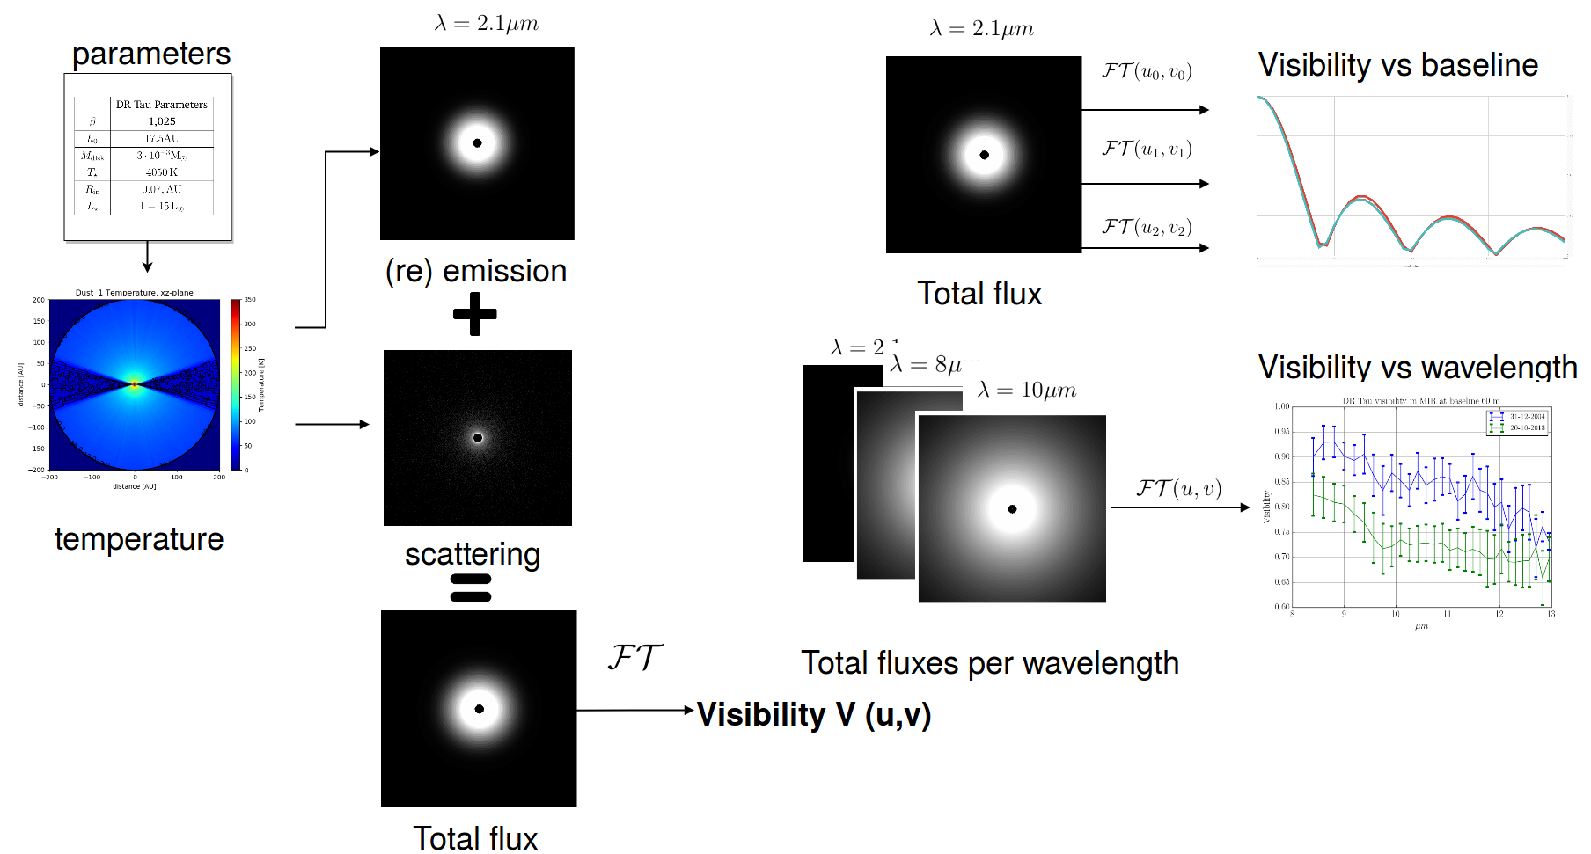
Method
26/03/19
© 2009 UNIVERSITÄT ROSTOCK | FAKULTÄT FÜR INFORMATIK UND ELEKTROTECHNIK
‹#›
Notes:
For a given dataset we calculate the temperature distribution as accurately as possible.
From the temperature distribution we calculate the thermal emission map, and the scattering map through raytracing for a given frequency
(Mie scattering for particles ~ wavelength, Rayleigh scattering for small particles)
We then either take more of these pictures of the total flux and do the FT for one given baseline, which is similar to what is done in observations. Baseline is kept the same, multiple pictures are taken
Or take one picture and theoretically change the basline, which gives us more information as we can theoretically transform it back to the same picture

Slide 19
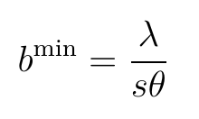
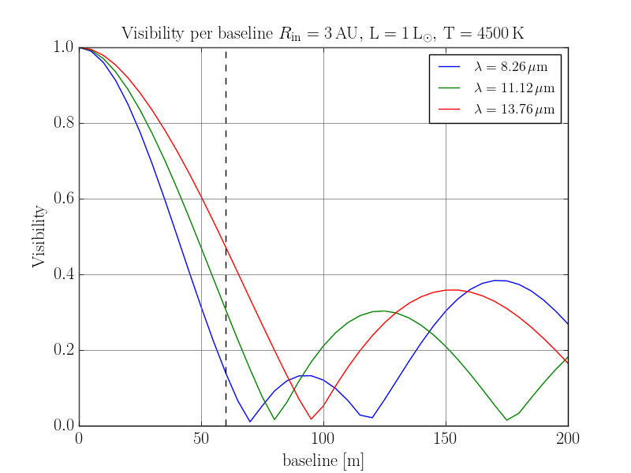
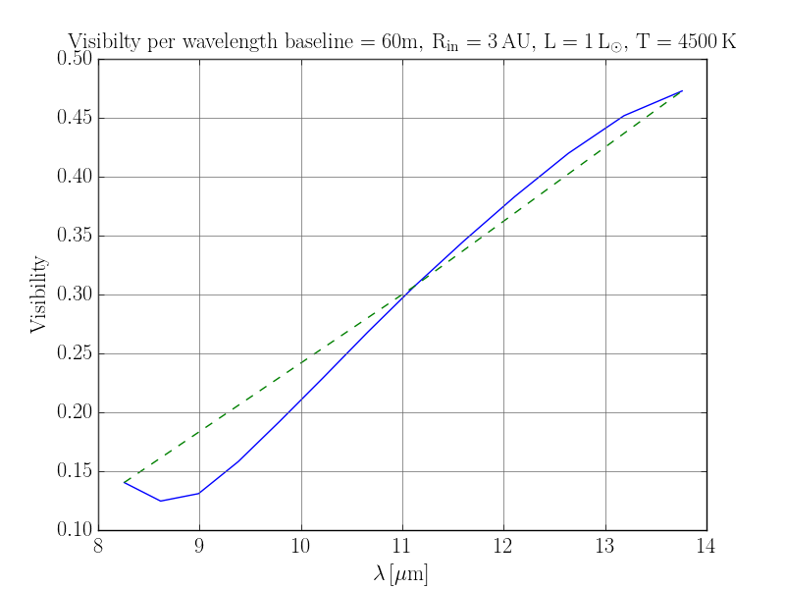
Quick result analysis
26/03/19
© 2009 UNIVERSITÄT ROSTOCK | FAKULTÄT FÜR INFORMATIK UND ELEKTROTECHNIK
‹#›
Notes:
Let’s look at a visibility curve of the same object, a symmetrical circumstellar disk with inner radius 3 AU, face on, T 4500 K, L=1
When we look at different freqeuncies we have visibility minima (a better visibility) at slightly different baselines
If we are taking measurements of this object at one baseline, we are looking at the dotted line

Slide 20
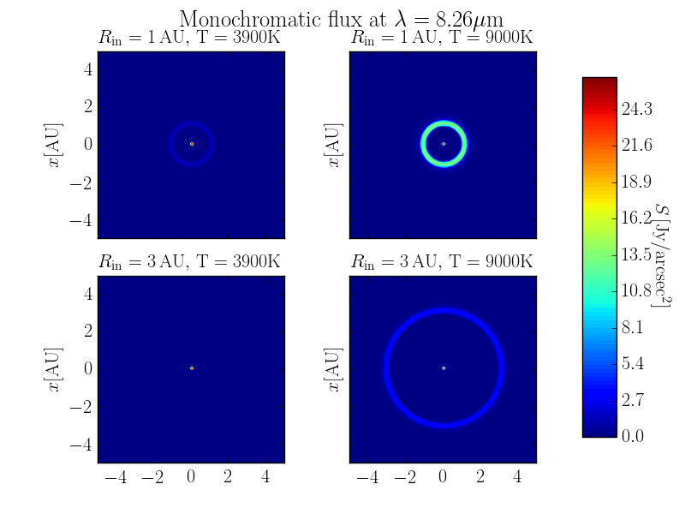
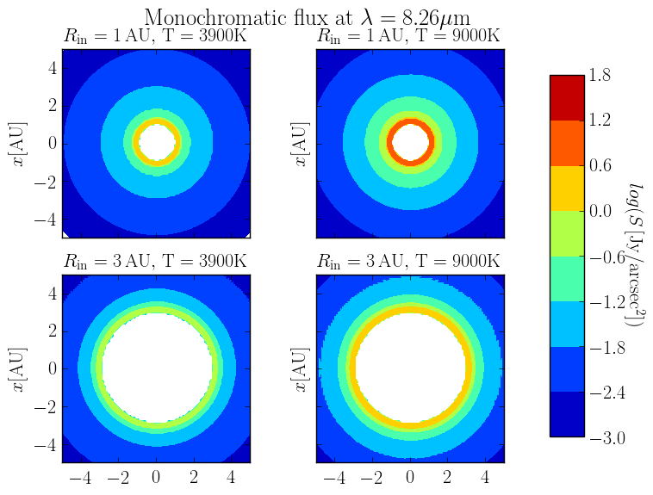
Temperature and inner radius variation
26/03/19
© 2009 UNIVERSITÄT ROSTOCK | FAKULTÄT FÜR INFORMATIK UND ELEKTROTECHNIK
‹#›

Slide 21
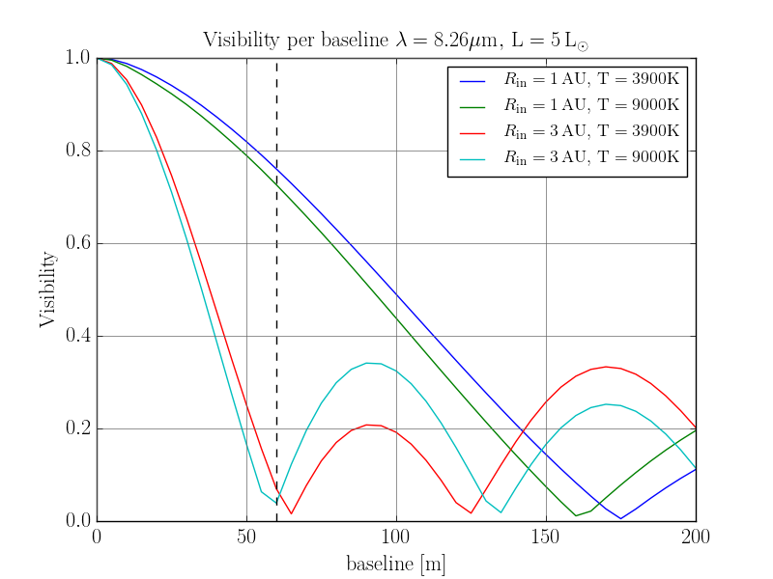
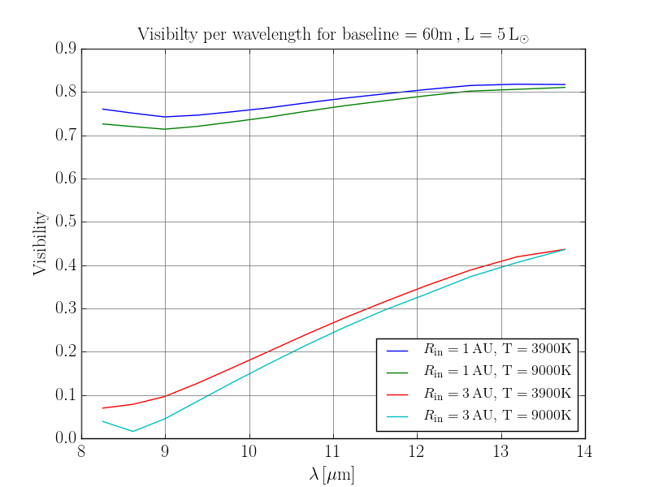
Temperature and inner radius variation
26/03/19
© 2009 UNIVERSITÄT ROSTOCK | FAKULTÄT FÜR INFORMATIK UND ELEKTROTECHNIK
‹#›

Slide 22
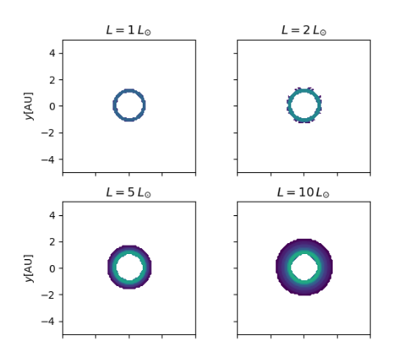
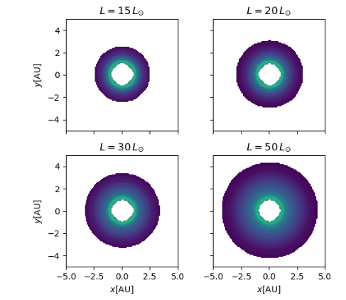
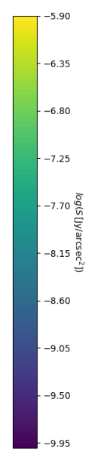
Luminosity variation
Variation of brightness with luminosity at λ = 8.2 μm, for a disk with R_{in} = 1 AU, and star with T⋆ = 3900 K, cut-off value at 5⋅10⁻¹¹ Jy/arcsec²
26/03/19
© 2009 UNIVERSITÄT ROSTOCK | FAKULTÄT FÜR INFORMATIK UND ELEKTROTECHNIK
‹#›
Notes:
L =1, T max = 250
L= 5, T max = 350 Peak emission
L= 20, T max = 590
L= 50, T max = 650
Less intense for 50 because peak emission is now in the NIR
λ max =2897,8 μm K
Visibility curve narrower because extinction happens later and starlight penetrates farther into the disk
Flux at lambda wider

Slide 23
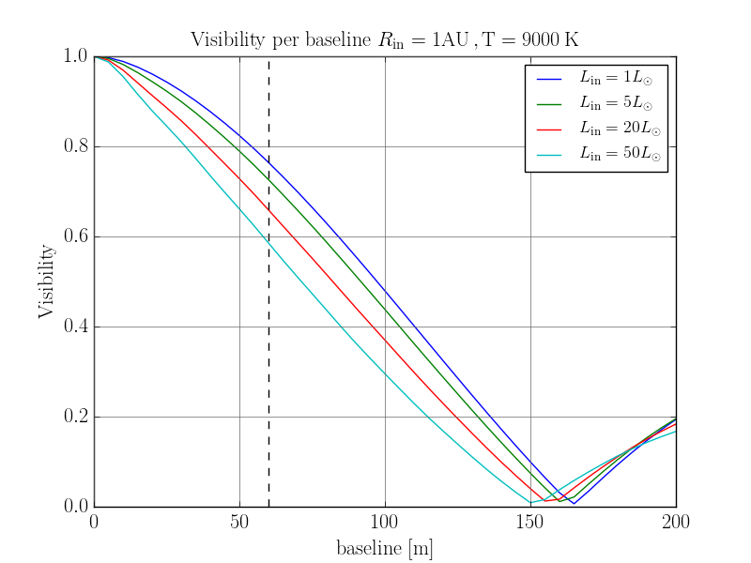
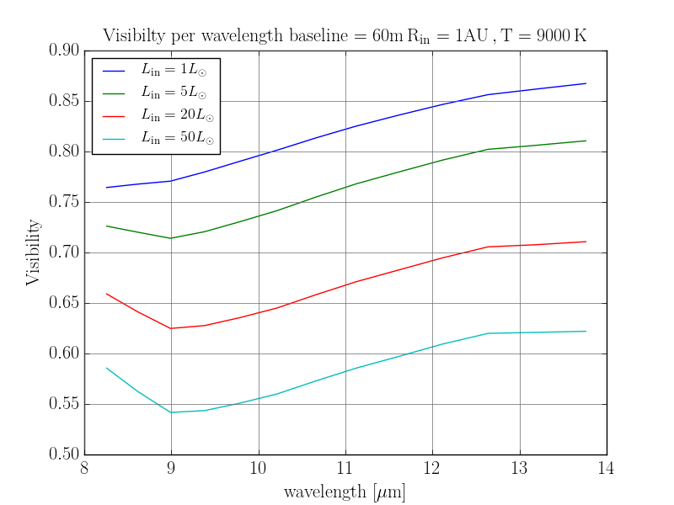
Luminosity variation MIR
26/03/19
© 2009 UNIVERSITÄT ROSTOCK | FAKULTÄT FÜR INFORMATIK UND ELEKTROTECHNIK
‹#›
Notes:
Visibility drop by up to 20% for change just in the luminosity, star expands radius while keeping outer layer temperature

Slide 24

Luminosity variation MIR
26/03/19
© 2009 UNIVERSITÄT ROSTOCK | FAKULTÄT FÜR INFORMATIK UND ELEKTROTECHNIK
‹#›
Notes:
Visibility drop by up to 20% for change just in the luminosity, star expands radius while keeping outer layer temperature

Slide 25


Luminosity variation NIR
26/03/19
© 2009 UNIVERSITÄT ROSTOCK | FAKULTÄT FÜR INFORMATIK UND ELEKTROTECHNIK
‹#›
Notes:
In the NIR visibility changes due to luminosity are minor
Hot gas does not change position that much, nor flux, still near rim 1000K
Difference 3 %

Slide 26

DR Tau: visibility against wavelength
26/03/19
© 2009 UNIVERSITÄT ROSTOCK | FAKULTÄT FÜR INFORMATIK UND ELEKTROTECHNIK
‹#›

Slide 27
Conclusions
in the parameter space explored [1 − 50L*], greatest influence in the MIR
little to no consequence in the NIR (maximum variance 3.82%)
maximum variance caused by a change in luminosity is of 48.1% (T = 5 000 K,
R_{in} = 0.1 AU at λ = 13.76 μm, L=50L₀)
Knowing the inner radius and the geometry of the disk, one could, with sufficient simulations determine the relation between the drop in visibility and the increase in luminosity
A change in magnitude of 1.6 is sufficient to account for a similar drop in visibility to the data on DR Tau
DR Tau is not fitted by current models, and there are other possible causes for the change in visibility (porosity of grains, change in radius of disk, geometry etc)
9/12/18
© 2009 UNIVERSITÄT ROSTOCK | FAKULTÄT FÜR INFORMATIK UND ELEKTROTECHNIK
‹#›

Slide 28
Thank you!

Slide 29
Questions?

Slide 30
Extra Slides

Slide 31

A1. Star Formation
Figure 1: Stages of formation of a Sun-like star. Credit: Greene, 2001
9/12/18
© 2009 UNIVERSITÄT ROSTOCK | FAKULTÄT FÜR INFORMATIK UND ELEKTROTECHNIK
‹#›
Notes:
We are interested in pre-main sequence stars, before they start fusion when they are forming.
Questions that we ask:
Why do we care?
Because they are a reflection of the past solar system.
Because we can observe them

Slide 32


A2. Dust properties
[1],[2] Credit: ESO
9/12/18
© 2009 UNIVERSITÄT ROSTOCK | FAKULTÄT FÜR INFORMATIK UND ELEKTROTECHNIK
‹#›
Notes:
Dust optically thick in the visible range
Scatters UV light due to size, and allows IR to pass through
Interstellar dust causes reddening of the light/image adding a peak at approx 6 micron
Dust temperatures near star 100 - 1000 K => disks are better observed in the infrared
Traditional telescopes are not large enough to observe such faint, distant objects
Astronomical interferometer is an array of separate telescopes, mirror segments, radio antennas that work together to provide a higher resolution image

Slide 33

A3. Instruments
9/12/18
© 2009 UNIVERSITÄT ROSTOCK | FAKULTÄT FÜR INFORMATIK UND ELEKTROTECHNIK
‹#›
Notes:
The VLT can operate each 8 m telescope individually or combine up to three telescopes together using the VLTI or Very Large Telescope Interferometer.
MIDI: mid-infrared instrument using 2 telescopes
AMBER: 3 telescope instrument in the near infrared.
VLTI second generation instruments:
MATISSE
- working as expected since the beginning of 2017
- covering wavelengths from 3–13 micrometres (µm)

Slide 34

A4. T Tauri Data
9/12/18
© 2009 UNIVERSITÄT ROSTOCK | FAKULTÄT FÜR INFORMATIK UND ELEKTROTECHNIK
‹#›
Notes:
The VLT can operate each 8 m telescope individually or combine up to three telescopes together using the VLTI or Very Large Telescope Interferometer.
MIDI: mid-infrared instrument using 2 telescopes
AMBER: 3 telescope instrument in the near infrared.
VLTI second generation instruments:
MATISSE
- working as expected since the beginning of 2017
- covering wavelengths from 3–13 micrometres (µm)

Slide 35
References
BECKWITH, S. V. W.: Circumstellar Disks. In: LADA, C. J. (Hrsg.) ; KYLAFIS, N. D. (Hrsg.): NATO Advanced Science Institutes (ASI) Series C Bd. 540, 1999 (NATO Advanced Science Institutes (ASI) Series C), S. 579
BRUNNGRÄBER, R.: Beobachtbarkeit von ausgewählten Strukturen und Staubeigenschaften zirkumstellarer Scheiben in verschieden Entwicklungsstadien, Dissertation, CAU Kiel, 2018
COHEN, MARTIN AND EMERSON, J. P. AND BEICHMAN, C. A.: A reexamination of luminosity sources in T Tauri stars. I - Taurus-Auriga. In: Astrophysical Journal 339 (1989), S. 455–473
GREENE, T. P.: Protostars. In: American Scientist 89 (2001), S. 316–325
KARTTUNEN, H. ; KRÖGER, P. ; OJA, H. ; POUTANEN, M. ; DONNER, K. J.: Fundamental Astronomy. 6. Springer, 2017. http://dx.doi.org/https://doi.org/ 10.1007/978-3-662-53045-0. http://dx.doi.org/https://doi.org/10.1007/ 978-3-662-53045-0. – ISBN 978–3–662–53044–3
LYNDEN-BELL, D. ; PRINGLE, J.E.: The evolution of viscous disks and the origin of the nebular variables. Monthly Notices of the Royal Astronomical Society, 168:603-637, 1974
OBER, F.; WOLF, S.; URIBE, A.; KLAHR, H.: Tracing planet-induced structures in circumstellar disks using molecular lines, Astronomy & Astrophysics, 601, May 2017
PERCY, J.R.: Understanding Variable Stars, ISBN: 9780521232531, 2007
SHAKURA, N. ; SUNYAEV, R.: Black holes in binary systems. Observational appearance. Astronomy & Astrophysics, 24:337-355, 1973
9/12/18
© 2009 UNIVERSITÄT ROSTOCK | FAKULTÄT FÜR INFORMATIK UND ELEKTROTECHNIK
‹#›

